Slide 1
Cadbury
STP Process & Marketing Mix

Slide 2
STP Process
Product
Price
Define Market
Place
Segment Market
Promotion
Target a Segment
People
Position
Process
Physical Evidence
Notes:
Following McCarthy’s STP Process, which was later developed by Booms and Bitner we can seek insight into the market and effectively segment and target Cadburys ideal audience

Slide 3
STP Process: Define Market
Mass Market
The confectionary world is one of a mass market – 95% of the UK’s population consumes chocolate
Differentiated
However, there are several segments that do not consume that much chocolate for a variety of reasons such as health, money, influence from the news, etc.
Niche Market
Cadbury is already an established chocolate brand worldwide and within the UK is the biggest chocolate provider however in certain segments it falls short – we will identify these segments

Slide 4
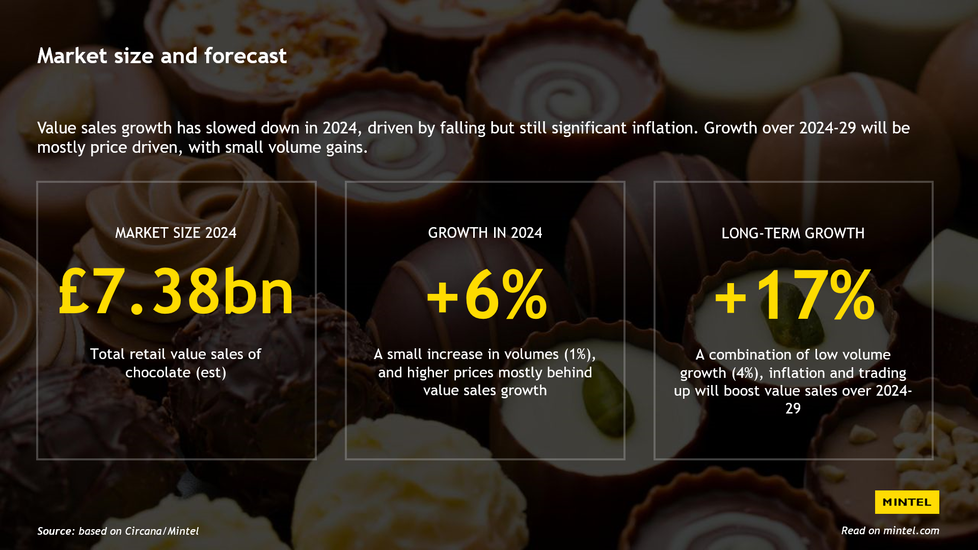
Notes:
To note –
The market is set to increase due to higher prices although volume of chocolate sales will decrease due to this. However, this will still result in profit and a growing industry
While inflation has impacted the higher prices, it is near levelling out and is the best it has been in a few years.
However, during these times of decreasing chocolate sales, it is key to identify where the audience is spending their money and also what audiences you could push to buy more chocolate to combat the decrease.

Slide 5
Segmentation: Geographical
In the UK Cadbury remains as the biggest brand for chocolate
95%
of UK adults eat chocolate

Slide 6
Comment on Market
 | 2021/22* | Share | 2022/23** | Share | 2023/24*** | Share | % change
 | £m | % | £m | % | £m | % | 2023-24
Lindt Lindor (Lindt & Sprüngli) | 142 | 10 | 141 | 10 | 150 | 9 | +6.4
Celebrations (Mars Wrigley) | 81 | 6 | 85 | 6 | 97 | 6 | +14.1
Cadbury Heroes (Mondelēz) | 76 | 5 | 81 | 6 | 95 | 6 | +17.3
Ferrero Rocher (Ferrero) | 79 | 6 | 85 | 6 | 94 | 6 | +10.6
Quality Street (Nestlé) | 82 | 6 | 84 | 6 | 83 | 5 | -1.2
Maltesers (Mars Wrigley) | 52 | 4 | 57 | 4 | 62 | 4 | +8.8
Toblerone (Mondelēz) | 32 | 2 | 40 | 3 | 54 | 3 | +35.0
Notes:
To note –
Purchase of occasion chocolate has been increasing as well as the liking of premium chocolate – 59% of eaters and buyers of chocolate buy premium chocolate for themselves
Cadbury does not do well in that department overall – however heroes is the 3rd most bought
Cadbury already dominates the seasonal chocolate with Crème egg and mini egg

Slide 7
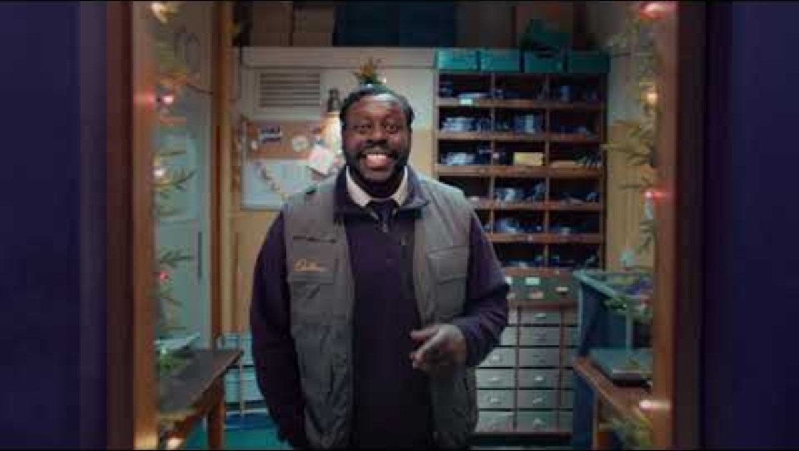
Comment on Market: Continuation
Notes:
Occasion chocolate does not necessarily fit Cadburys brand positioning and messaging although they have recently been leaning towards it with more promotion adverts, however these are still pushing for everyday chocolate or large block bars on an Occasion as seen in their recent Cadbury advert compared to market leaders' idea of occasion chocolate such as Lindor, Celebrations, Quality Street, Ferroro Rocher just to name a few examples.
For these reasons I will not be targeting the increasing occasional chocolate market

Slide 8
Segmentation: Behavioural
People try to eat healthy, but it remains a fact that 95% of the UK eat chocolate and of that number 69% seen in 2022 eat chocolate at least twice a week.
Large blocks and single-serve bars remain the most consumed chocolate

Slide 9
Segmentation: Psychographic
71% of chocolate is bought on impulse which is predominantly everyday bars.
Volume of chocolate sales has decreased due to regulations and cost of living
Notes:
Single serve bars and large block bars still remain the most bought
While volumes of chocolate sales has decreased it is clear that even with people being affected by money issues and their mixed opinion of the living crisis, it still remains that sales of everyday chocolate keeps increasing.
Maslow’s Hierarchy of needs – esteem/physiological needs (can be argued either way)

Slide 10
Segmentation: Generational
The UK population is expected to increase by nearly 3 million by 2044.
Falling birth rate is concerning due to children and young adults being the biggest consumer of Chocolate.
Notes:
Therefore, there is a need to tap into the audience of the aging population which is still set to increase in the future. Targeted messages now to the aging audience will be of importance for the future but also to tap into that key market now of 65+

Slide 11
Targeting: Aging Population
Aging population for targeting will begin from 45+
Young people remain the biggest consumers of chocolate with no change estimated to happen in the future.
Therefore, be targeting an older audience who are consuming less chocolate but is a growing sector

Slide 12
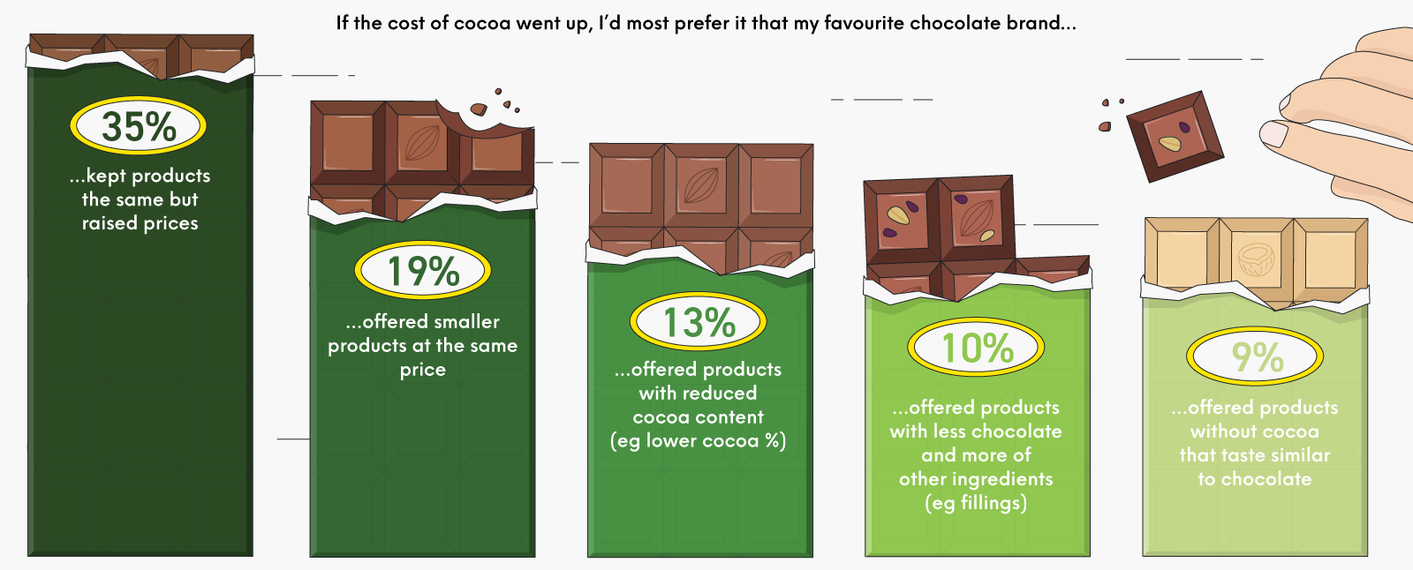
Targeting: Health
The majority of age ranges do not want to see a cocoa substitute
More people would see prices raise than cocoa be removed or decreased from the product
Notes:
As established 71% of UK adults strive to eat healthier, this can be seen through earlier facts as well as news reports regarding Ultra-Processed foods (UPFs). 46% of people notice news/social media stories and 64% see highly processed foods as unhealthy – that is nearly 20% of the audience believing UPFs to be bad and to be avoided. It is also safe to assume the people consuming this news the most is that ageing generation. Most news by people of the age 45+ are from the tv and these are the biggest viewers of tv according to Ofcom.
With this being said, people want and almost need to consume chocolate. The age demographic being targeted want the same levels of cocoa in their product even if this raises prices they want chocolate. While there is a good push for reduced cocoa in products this unfortunately is not an option for Cadbury due to its positioning around taste.

Slide 13
Targeting: HFSS Restrictions
“Under NPM, products get ‘bad’ points for high saturated fat, sodium, sugar and energy per 100g and ‘good’ points for fibre, protein, and fruit, vegetable and nut content. These are therefore the levers that manufacturers of affected foods and drink can push and pull to make their products non-HFSS.”
Notes:
HFSS or high in fat, salt or sugar is a restriction focused on a selected range of categories deemed unhealthy for children's’ health.
These specifically target products high in saturated fat, sodium, sugar and energy per 100g. Chocolate fits under this category.
The previous slide stated people want the same levels of cocoa not the same level of chocolate. If you were to reduce the volume of cocoa, this would affect the taste of the chocolate. However, if you were to reduce the volume of chocolate this reduces the amount of chocolate someone receives.

Slide 14
Targeting: Flavours
Nuts and dried fruit are quick to identify on this list as popular and conveniently score high ‘good’ points
A chocolate bar with two fillings is also the most ideal product in the current market
Notes:
With this information you can identify a key insight into the market. A chocolate bar of single serving and large block size that has two fillings of nuts and dried fruit containing a lower volume of chocolate.
This idea isn’t new, Cadbury and many other chocolate brands have got dried fruit and nut bars, however this will be advertised as “Brand new and extra fillings in the bar”, masking the decrease in chocolate volume and pushing the agenda of health.
It is possible to take this one step further as well and make it a premium bar with increased cocoa content due to 73% of chocolate buyers believe premium chocolate is worth buying. However, this does not fall within Cadbury’s brand positioning. Nor does the desire for those wanting less cocoa as Cadburys main positioning is orientated around its taste.

Slide 15
Positioning
Resonance – “Taste like this feels”
Resonance
Judgements | Feelings – Cadbury produces a sense of joy, enjoyment and youth
Judgements
Feelings
Performance | Imagery – Provides close sentiment to audiences
Performance
Imagery
Salience – 200 years of chocolate expertise and the second biggest confectionary brand in the world
Salience
Notes:
Keller’s Pyramid:
Salience – Mondelez the owner of Cadbury, Dairy Milk, Purple, Specific font, “Taste like this feels”, Second biggest confectionary brand in the world, Block of Chocolate
Performance/Imagery - Cadbury provides nearly 200 years of chocolate expertise which has been with people since before they were born, it could have been there for them during their lows and their highs. Providing close sentiment to audiences as if "for the people" which can be shown through their Christmas advert of giving away a free piece of chocolate? As their old slogan states, "feel the joy“
Judgements/Feelings – Cadbury produces a sense of joy, enjoyment and youth. It is giving and provides customers with happiness at even their simplest chocolate bar of dairy milk. Seasonal chocolate such as crème eggs and mini eggs create excitement and anticipation. Past experimental advertisement has also resonated with audiences to never forget the brand, or the joy provided e.g. the gorilla advert
Resonance – The current message of Cadbury which replaced feel the joy in 2016 is “Taste like this feels”. Cadbury is arguably the most successful selling confectionary in the UK and clearly customers resonate with the message of its taste, consuming what they believe to be tasty. Through this taste, Cadbury can create loyalty due to its superior product which will lead to brand advocacy as customers inform or recommend people to try certain Cadbury chocolate bars

Slide 16
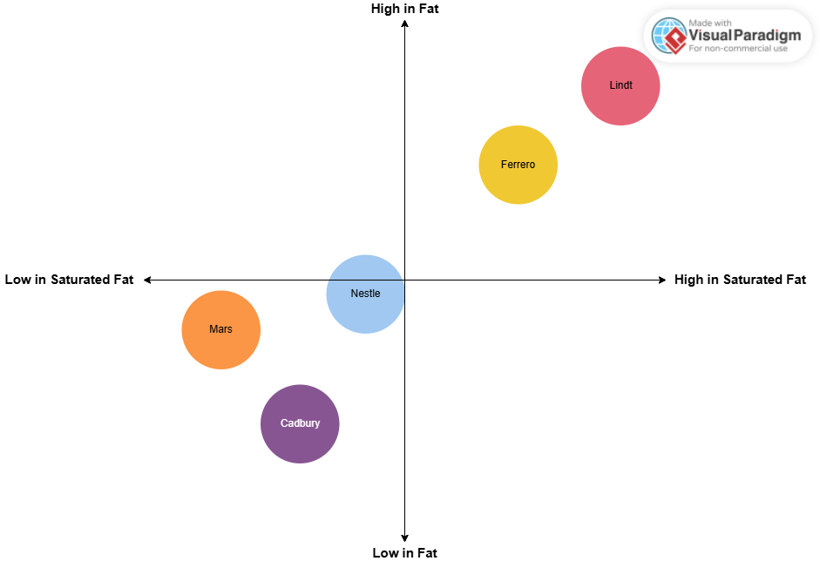
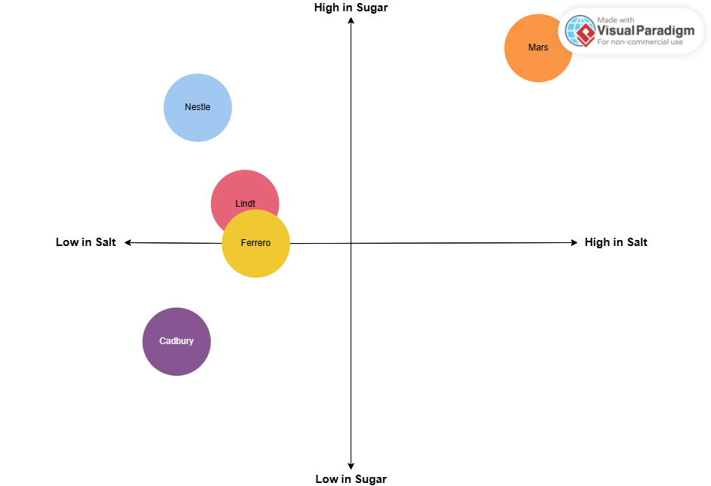
Competitors: Perceptual Map
Nestle (Smarties), Cadbury (Dairy Milk), Mars (Mars), Lindt (Lindt Bar), Ferrero (Ferroro Milk Chocolate & Hazelnut Bar)
Notes:
Currently, Cadbury by average is the healthiest choice of the main chocolate bars losing out to only mars in lowest saturated fats. It is also the second lowest in calorie count behind nestle.

Slide 17
Competitors: SWOT
Strength:
Healthiest option
Variety of flavours
Biggest selling chocolate brand in the UK
Biggest everyday and seasonal chocolate selling company
200 years of chocolate expertise
Weakness:
Lack of occasion chocolate
Brand dedicated to taste
Advertisement is rather expensive even with the money to pay for it
Opportunities:
Connecting with the ageing population
Occasional chocolate has seen a rise in sales
Threats:
HFSS Restrictions
Rise in cocoa prices
Inflation
Cost of living
Healthy living
Ageing population

Slide 18
Recommendations
“Newest Cadbury bar to hit the shelves with extra dried fruits and nuts, the healthiest chocolate bar available”
Paid | Owned | Earned
TV Adverts Bus stops/bus adverts Train advertisement Billboard | Social Channels (Instagram, X, Website. Facebook) SEO Blogs Website | Word of mouth (WOM) Blog posts Social Media News Fan communications
Notes:
Due to the predicited increase in sales for the future of the confectionary market, my recommended marketing strategy would enable the launch of a new product catered towards the specific target audience
Lower chocolate volume in chocolate to ‘dodge’ HFSS regulations and include increased health in products such as nuts and fruit – this will be advertised as something new and exciting – the inclusion of two fillings is also a popular filling choice
Healthy chocolate to be advertised to a growing audience who will be more health conscious
Continued advertisement via the TV which is the biggest media consumption of the target audience and the place they get the most news - TV Remains the dominant medium for advertising chocolate and according to Ofcom they are the biggest consumer of television
With the news pushing more healthy regulations and regulations being forced in October 2025 it will be better to get ahead of the curve as well as be healthy treat for customers to consume

Slide 19
Marketing Mix
Product – A healthy chocolate bar in the form of single-serve and large blocks with a lower chocolate volume but the normal cocoa amount to maintain taste.
Price – Ideally the price will be similar to the current Cadbury products on offer such as the dairy milk
Place – Available for delivery but predominantly in stores
Promotion – Benefits based promotion demonstrating how the product is healthier than competitors and fits into the lives of the UK population
People – Cadbury staff members and advertisement have an association of joy and happiness
Process – Being an old company much of the UK is already aware and associated with Cadbury for as long as they can remember
Physical Evidence – Heritage is beneficial to providing evidence
Notes:
Product – A healthy chocolate bar in the form of single-serve and large blocks with a lower chocolate volume but the normal cocoa amount to maintain taste
Price – Ideally the price will be similar to the current Cadbury products on offer such as the dairy milk to create a quality association which will reflect the quality expectation of a dairy milk. Prices may fluctuate due to HFSS restrictions however it should be aimed to be maintain the same price as a dairy milk.
Place – Cadbury is available for delivery as demonstrated by their own advertisement however it will predominantly be in stores and ideally on a higher shelf than the rest of the chocolate bars to be closer to eye level of customers and to reflect the HSFF restrictions
Promotion – Benefits based promotion demonstrating how the product is healthier than competitors and fits into the lives of the UK population. The majority of the advertisement will be TV based as that is the media the target audience consumes most which currently fits with on-going trends of the chocolate advertisement, however in-person selling and free samples could generate earned media as well as positive PR towards Cadbury and potential launch of a new product
People – Perception of Cadbury from staff members is hard to judge due to the chocolate being sold in superstores. While the Cadbury factory is open to visitors with positive reviews of staff most of the perception would be created through promotion
Process – Being an old company much of the UK is already aware and associated with Cadbury for as long as they can remember. Cadbury is shown to listen as with their return of the Wispa bar which was previously discontinued but brought back from customer appeal showcasing the company's empathy and relationship for its consumers.
Physical Evidence – As established Cadbury has been around for 200+ years in which it has a long history of listening to customers, creating new flavours and even returning flavours due to audience input. As for its main selling point, the taste, its heritage speaks for itself as stated already, much of the UK will have a connection with Cadbury since before they can remember which these feelings and emotions are the strongest form of evidence.
Overall, this push towards health should help engage Cadburys target audience towards a new mindset around confectionary's such as chocolate and resolve the limitations on snacking and sweet treats.

Slide 20
Cadbury
Drivers of customer behaviour within the UKs ageing population

Slide 21
Possible Drivers
Notes:
During the previous section I outlined a few reasons for possible drivers of customer behaviour these were health (mainly physical), finance and the environment.
The main one to focus on will be the increase in attention towards health and the push for an ageing population to improve their health as discussed in the news. The effects of this can be seen in the 71% of adults striving towards eating healthy. While the news can arguably be propaganda which works to inform people of the going-ons it does it from a viewpoint of the creator. Therefore, if you consistently watch the news like this audience does, you are more than likely apart of that viewpoint and appeal
With the news covering the topic, an authoritive informant, it puts one in the forefront, like you specifically are being talked to, as Gilovich, Medvee and Satvitsky states, putting you in the spotlight. You feel singled out and if you don’t fit their social norm you are shamed. Forced to compare yourself to others you know and those of influential status.
As health is a sensitive topic, it is easy to utilise one of the 6 primal stimuli as discussed by Morin and Renvoise: Contrast. By effectively scaring people with the news causing them to reflect on themselves and compare themselves to others in a split second, you can effectively push a new agenda of a healthy lifestyle, which can be clearly seen in the UK priority charts, above financial security which many deem to be very important with the cost of living crisis at the moment.

Slide 22
Physical Health
Increased push for a healthier lifestyle
Many adults believe themselves to be healthy
Notes:
There has been an improvement in health and a push for more adults to maintain a healthier lifestyle
In 2021, using the All statistics, over 50% of the population were overweight or obese. Now these are to be taken lightly as being overweight does not necessarily mean you’re unhealthy, but these statistics do not show the true case. However, in 2023, over 50% of the UK population believed to be somewhat healthy or very healthy.
You can identify in the 2 years that there must have been a big health push, which has become socially acceptable for many, it is the social norm as outlined by legros and Cislaghi

Slide 23
Ageing Population
Notes:
It is a fact that the UK has an ageing population, which is predicted to increase alongside the decrease in birth rates. This means those who exercised consistently before they couldn’t as much will potentially live longer. While it is a morbid thought, those who are aware of their bad health and want to improve may catch a case of FOMO. They will be scared of missing those extra years they could have potentially had. They compare themselves to an ideal future where they live longer.
FOMO
Social comparison

Slide 24
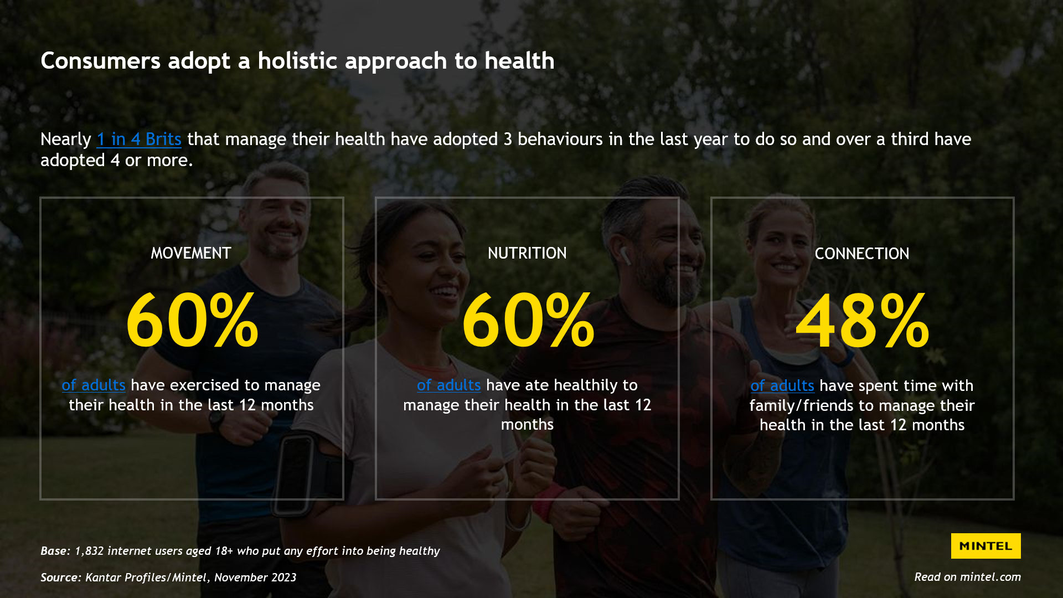
Notes:
As you can see on the slide, it is becoming the social norm to be health conscious, 60% of adults are eating more healthily as well as 60% of adults have exercised to manage their health. This is a big proportion of the population and based off the statistics before is only set to increase and become more socially acceptable.

Slide 25
Brand Positioning
What can Cadbury’s do to improve their position on health being a confectionary brand?
Notes:
Cadbury is a confectionary brand; it is inherently unhealthy. The biggest audience of Cadbury is their young audience who is slowly disappearing.

Slide 26
Resonance
“Newest Cadbury bar to hit the shelves with extra dried fruits and nuts, the healthiest chocolate bar available”
Notes:
The resonance of Cadbury is, “Taste like this feels”. Taste is the biggest thing, something that cannot be replaced or changed. A signal of taste and health, is the placement of the chocolate on the store shelf. Due to HFSS restrictions, a healthier chocolate bar will place higher on a shelf. As we know 71% of chocolate is bought on impulse, people catching it at eye level will be more inclined to take the first one they see as well as the best one. This is established by Cadbury status quo of being a company with 200+ years of chocolate expertise. Maintaining its resonance of taste and following the trend of the new health push, this should aid in creating an effective marketing scheme.
Therefore, knowing this the new selection choice as discussed in the previous section will be…
People who are try to maintain a healthy lifestyle are bombarded with numerous health tips, overloaded with choices but ones they cannot find reliable. However, if you have an influential, authorative and attractive figure, such as a scientist state, “this is healthy”, people are more inclined to believe. This is an example of selective perception, where people are more likely to believe something that aligns with their existing beliefs and attitudes.
If you were to combine this agenda of selective perception with social norm, customers would be more likely to buy a product from Cadbury due to the product aligning with their views as well as others views who are also buying the product.

Slide 27
Reinforcing the marketing
Two-sided message
Framing
Signalling Price
Notes:
People are aware chocolate is unhealthy, Cadbury is aware that chocolate is unhealthy, however by acknowledging this message and providing a contrasting one of health, you get people thinking and help people justify their purchase through a two-sided message.
You can frame this choice by pushing the healthy agenda as stated previously of the “New chocolate bar with extra dried fruits and nuts”. Additionally, you could a new resonance of juxtaposition, e.g. eating cadburys new bar is a non-guilty pleasure. There is no negative feeling due to it being healthier.
To reinforce the official Cadbury resonance of “taste like it feels”, you can signal the product quality through its price. Having it match others like dairy milk, signal to customers that the quality of the bar is of the same value, even if there is less chocolate in the bar, the quality of the taste remains the same.

Slide 28
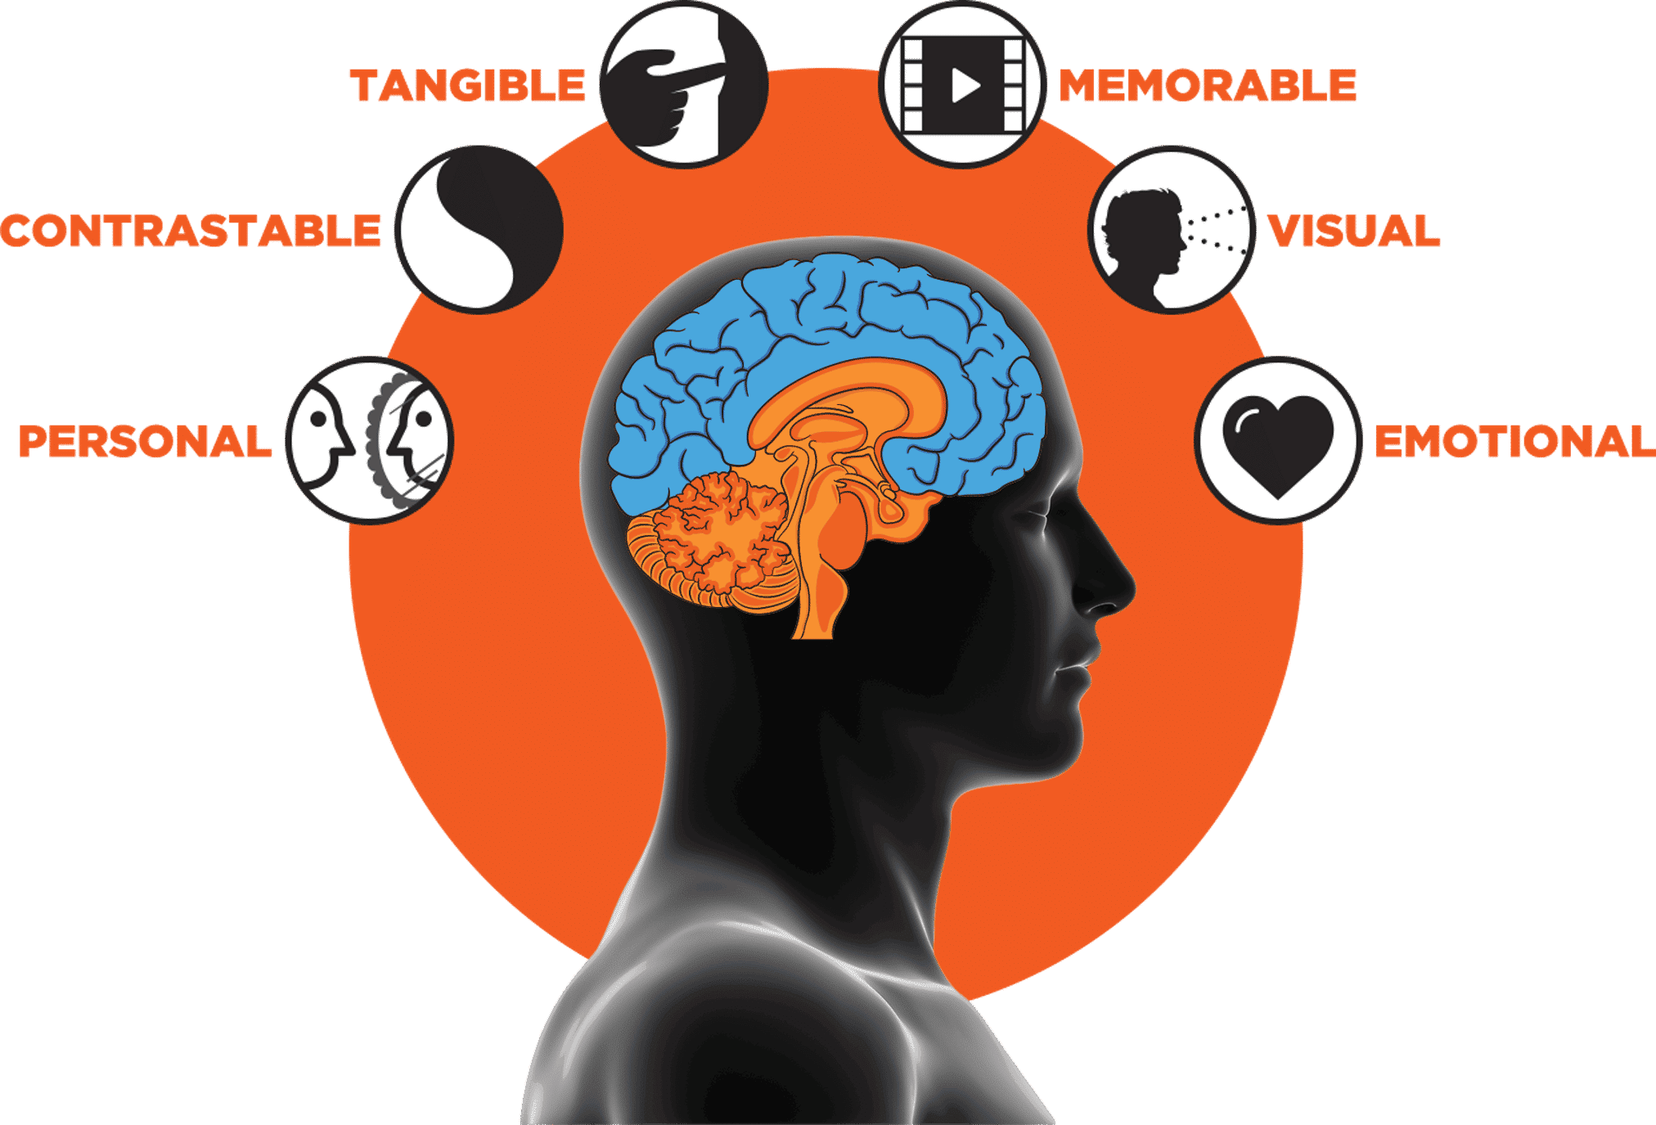
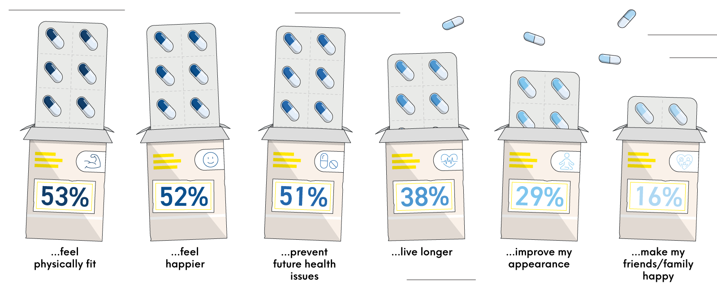
Influence: Driving the message home
Notes:
Following Morin and Renvoise’s 6 primal stimuli conceptual framework, we can communicate to an audience's primal brain.
Personal – discussing the unhappiness that comes with seeking health, the neglect of treats
Contrastable – however with the new Cadbury product you can achieve both health and that satisfaction of a treat all at once
Tangible – this can be shown through evidence of the bars packaging but also through an advertisement perhaps with an influential figure for those in the target audience, e.g. Meryl Streep.
Identifying a key figure for this role is crucial as the source attractiveness model argues that the physical appeal of a celebrity influences the effectiveness of the advertising message and intent to purchase. While some may argue this does not actually equate to an increase in sales, the celebrity still resonates joy and buzz around the product, creating a positive atmosphere and image towards a product. This will be beneficial towards a product such as a healthy chocolate bar campaign which aims to enrich peoples lives through a joyful yet healthy snack. This is an example of social proof bias where we showcase a positive testimonial or endorsement to influence buying decisions.
Memorable – Having such a figure speak for the brand would create reliability but also is a social indicator that this bar is acceptable for those in that age range, with a repeated sentiment of a healthy treat
Visual – this will be performed visually through a tv advert which is the most consumed form of media that the audience uses as well as the one Cadbury utilises the most
Emotional – finally the product will create a sense of joy, reminiscent of Cadburys old slogan, “Feel the joy”. This is important as high-arousal emotions like excitement and joy are better at grabbing attention in comparison to low-arousal ones.
Following all these steps, you create a positive social comparison for the audience to emulate the influencers activity of enjoying a healthy treat. By emulating this, you could categorise audiences to be in what Maslow would identify as self-esteem needs, where you alongside the 71% of adults striving for a healthy lifestyle differentiate yourself by doing it in a more enjoyable and fulfilling way.

Slide 29
Influence: Senses
Touch
Smell
Taste
Sound/hearing
Sight/Vision
Notes:
Building upon the previous slide, we will discuss the five senses which can aid in tapping into that primal brain. The senses have been proven to be critical in creating brand loyalty. However, how do we get our audience to experience the senses, this can be achieved through free sampling at stores or about on the streets. Ultimately, this free sample should invoke a feeling of reciprocity, the idea that people feel obligated to return a favour. Additionally, by conducting these samples in areas with an established ageing population you can create a forer effect.

Slide 30
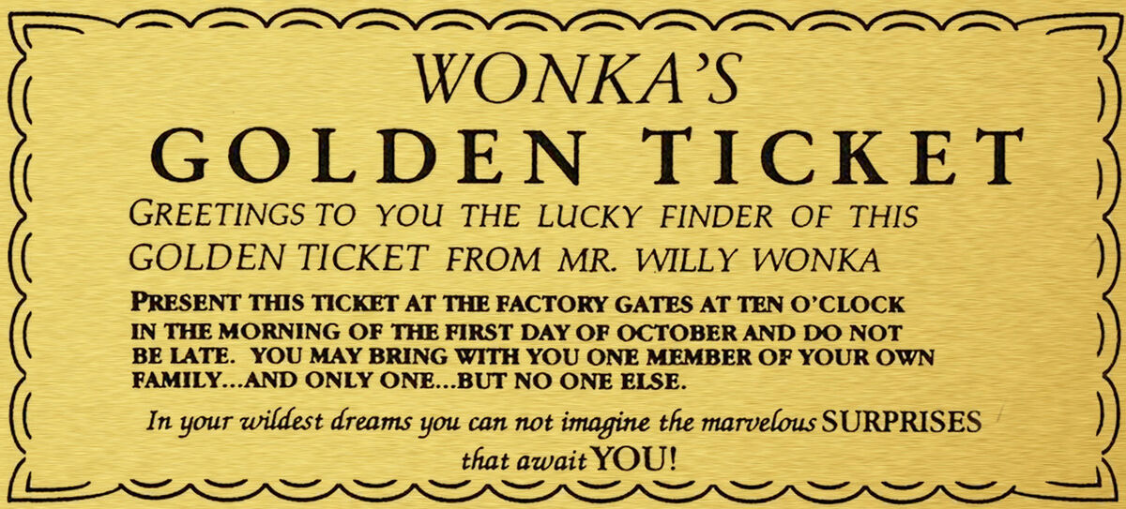
Post Purchase Experience
Notes:
After the product has been consumed how can we improve the experience or maintain its positive messaging. Simply we can add a message on the inside of the chocolate wrapping, one as simple as “keep it up” or “you got this”. This extra health push aligning with the customers wants is Cadbury actively engaging and aligning with customer wants and needs. This trust should increase brand loyalty towards Cadbury and keep the customer coming back for more through confirmation bias, a message that aligns with customers’ existing beliefs to leverage confirmation bias.

Slide 31
References
Bellaouaied, M. (2024) STP Process Material. Customer Behaviour [online]. Available from: https://blackboard.uwe.ac.uk/ultra/courses/_364589_1/cl/outline [Accessed 02 October 2024].
Bernays, E. (1928) Propaganda [online]. Horace Liveright [Accessed 18 December 2024].
Bernays, EL. Miller, MC. (2005) Propaganda [online]. Brooklyn, N,Y:Ig Pub. [Accessed 18 December 2024].
Caines, R. (2024) Chocolate Confectionary – UK – 2024, Mintel (2024 version) [online]. Available from: https://clients.mintel.com/content/report/chocolate-confectionery-uk-2024?fromSearch=%3Fargs%3D%252Fhomepages%252Fdefault%252F%26freetext%3Dcadbury%26sortBy%3Drecent%26start%3Dredirect%26resultPosition%3D1 [Accessed 12 December 2024].
Cadbury (2022) Cadbury Secret Santa Postal Service. YouTube [video]. 18 November. Available from: https://www.youtube.com/watch?v=aqIpHfWEY_0 [Accessed 16 December 2024].
CIM (2015) A brief summary of marketing and how it works. Marketing and the 7Ps [online]. pp. 1-12. [Accessed 01 October 2024].
Gabay, J. (2015) Brand psychology: consumer perceptions, corporate reputations. London: Kogan Page. [Accessed 20 December 2024].
Green, T.B. (2024) Introduction to psychology. Customer Behaviour [online]. Available from: https://blackboard.uwe.ac.uk/ultra/courses/_364589_1/cl/outline [Accessed 18 December 2024].
Green, T.B. (2024) Introduction to psychology. Customer Behaviour [online]. Available from: https://blackboard.uwe.ac.uk/ultra/courses/_364589_1/cl/outline [Accessed 18 December 2024].
Green, T.B. (2024) Understanding the online audience. Customer Behaviour [online]. Available from: https://blackboard.uwe.ac.uk/ultra/courses/_364589_1/cl/outline [Accessed 27 November 2024].
Hawker, K. (2019) Keller’s Brand Equity Model – What It Is & How to Use It. Medium [blog]. 26 September. Available from: https://medium.com/@keatonhawker/kellers-brand-equity-model-what-it-is-how-to-use-it-84e42d562299 [Accessed 16 December 2024].
Jamaluddin, M.R., Hanafiah, M.H. and Zulkifly, M.I. (2013) Customer-based Psychology Branding. Procedia – Social and Behavioral Sciences [online]. 105, pp. 772-780. [Accessed 20 December 2024].
Keel, A. & Nataraajan, R. (2012) Celebrity Endorsements and Beyond: New Avenues for Celebrity Branding. Psychology & Marketing [online]. 29 (9), pp. 690-703. [Accessed 20 December 2024].
LinkedIn (2024) Psychology Fundamentals for Marketing and Sales Success. LinkedIn Learning [video]. 10 October. Available from: https://www.linkedin.com/learning/psychology-fundamentals-for-marketing-and-sales-success/unlock-customer-minds?resume=false&u=56744785 [Accessed 20 December 2024].
Mcleod, S. (2024) Maslow’s Hierarchy Of Needs. SimplyPsychology [blog]. 24 January. Available from: https://www.simplypsychology.org/maslow.html [Accessed 18 November 2024].
Nguyen, S. (2024) Health and Wellness in the Home – UK – 2024, Mintel (2024 version) [online]. Available from: https://clients.mintel.com/content/report/health-and-wellness-in-the-home-uk-2024 [Accessed 18 December 2024].
Ofcom (2017). Adults’ Media Use and Attitudes report, Ofcom (2017 Version) [online]. Available from: https://www.ofcom.org.uk/siteassets/resources/documents/research-and-data/media-literacy-research/adults/adults-literacy-2017/section-9-newer-narrow-non-users-internet.pdf?v=322533 [Accessed 12 December 2024].
Ofcom (2022). Adults’ Media Use and Attitudes report, Ofcom (2022 Version) [online]. Available from: https://www.ofcom.org.uk/siteassets/resources/documents/research-and-data/media-literacy-research/adults/adults-media-use-and-attitudes-2022/adults-media-use-and-attitudes-report-2022.pdf?v=327649 [Accessed 12 December 2024].
Ofcom. (2024). Gen Z swerves traditional broadcast TV as less than half tune in weekly. Media use and attitudes [online]. [Accessed 12 December 2024].
Sales Brain. (2021) The NeuroMap Overview. Available from: https://www.salesbrain.com/neuromap-overview/6-stimuli/ [Accessed 19 December 2024].
Smith, F. (2024) Attitudes towards Health Management – UK – 2024, Mintel (2024 version) [online]. Available from: https://clients.mintel.com/content/report/attitudes-towards-health-management-uk-2024 [Accessed 18 December 2024].

